Slide 1
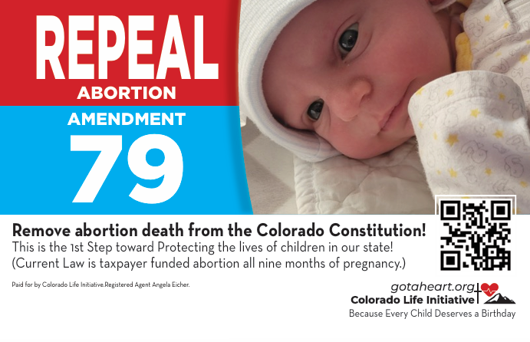
Sign and Pick up Your Petition Today!
Matthew 18:14
So it is not the will of my Father who is in heaven that one of these little ones should perish.
​

